Slide 1

William Roberts Task 9 Prof. Stephen Legget

Slide 2
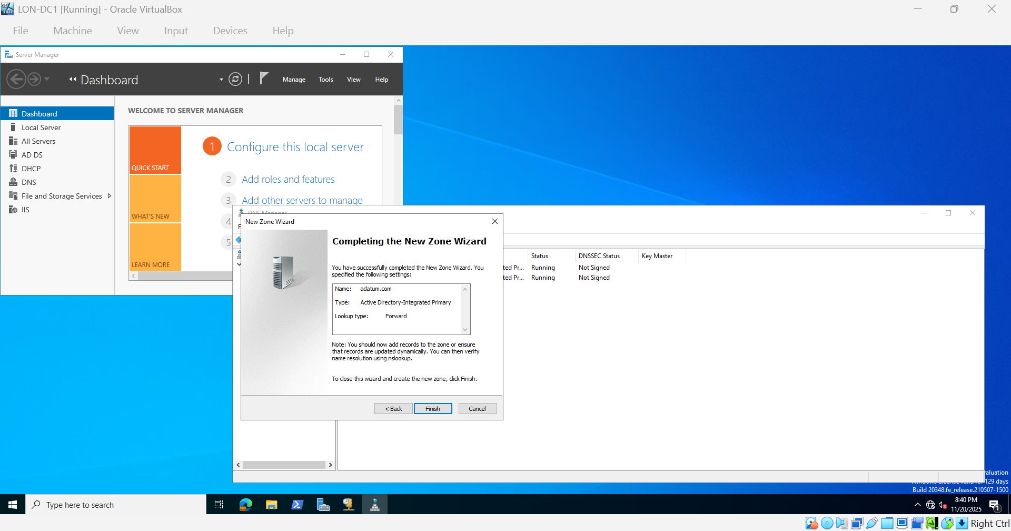
Add new Forward Lookup Zone
In DNS expand to be able to see Forward Lookup Zone
Add new zone named adatum.com and allow both nonsecure and secure dynamic updates.

Slide 3

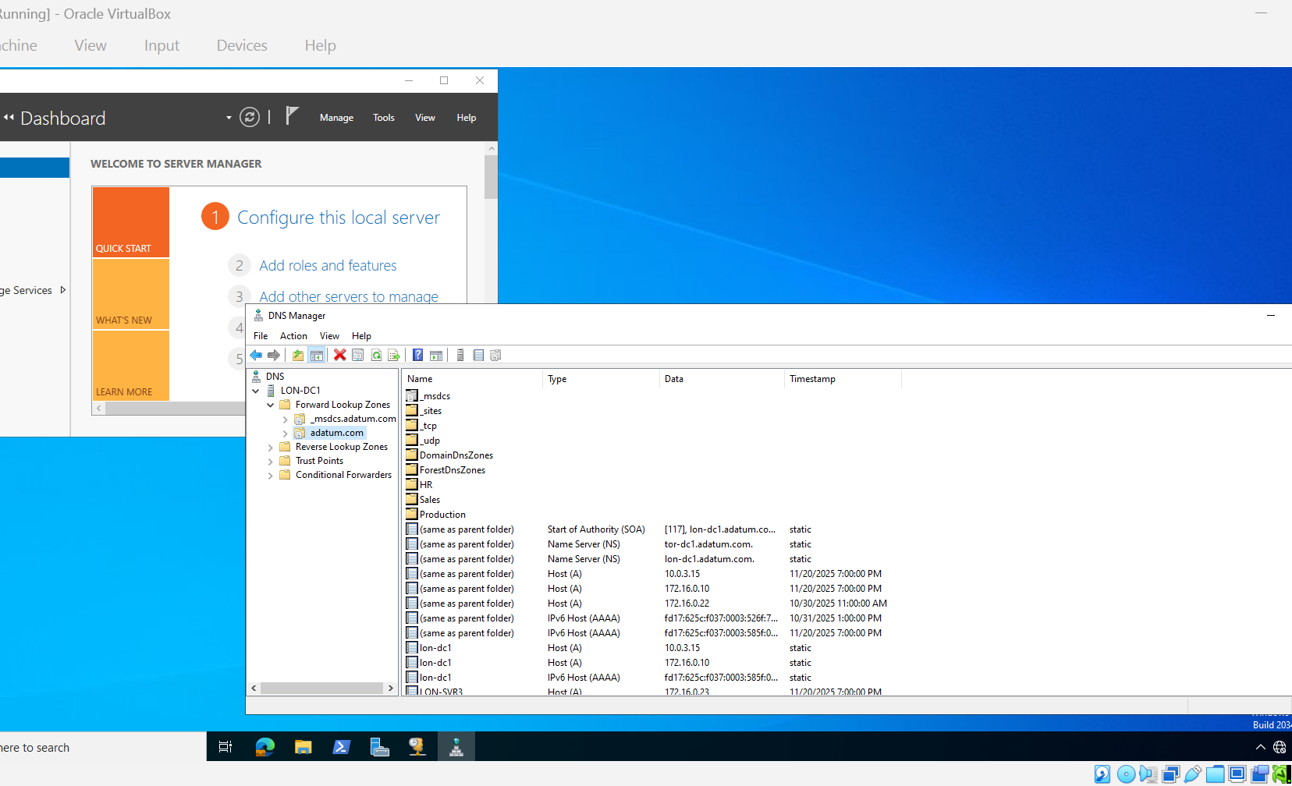
Create DNS Subdomains
Create interal domains
HR
Sales
Production

Slide 4
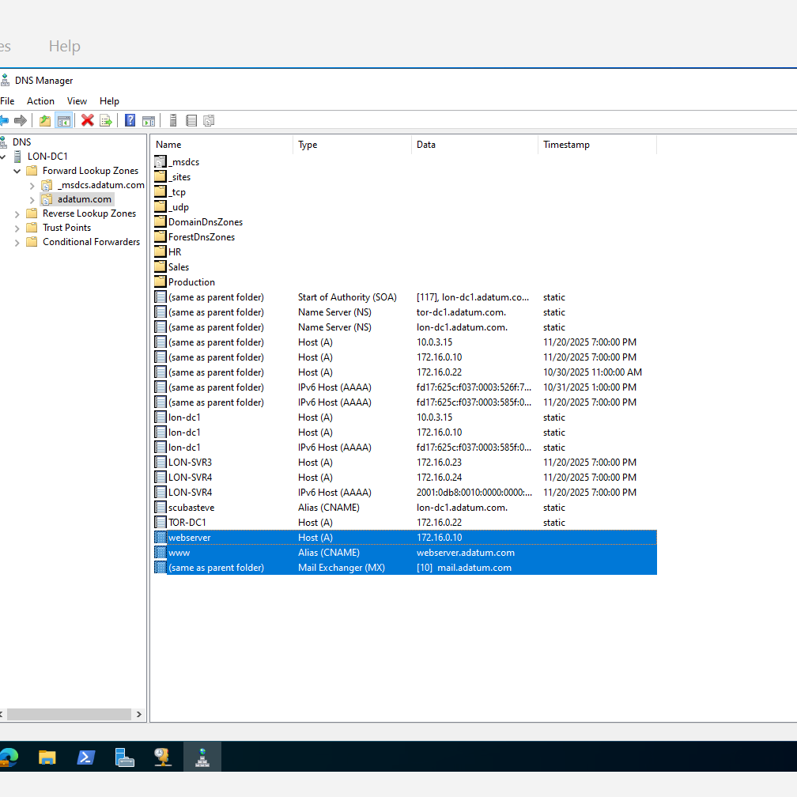
Create Resource Records
Crated new host A or AAA
Created alias
Created Mail Exchanger

Slide 5
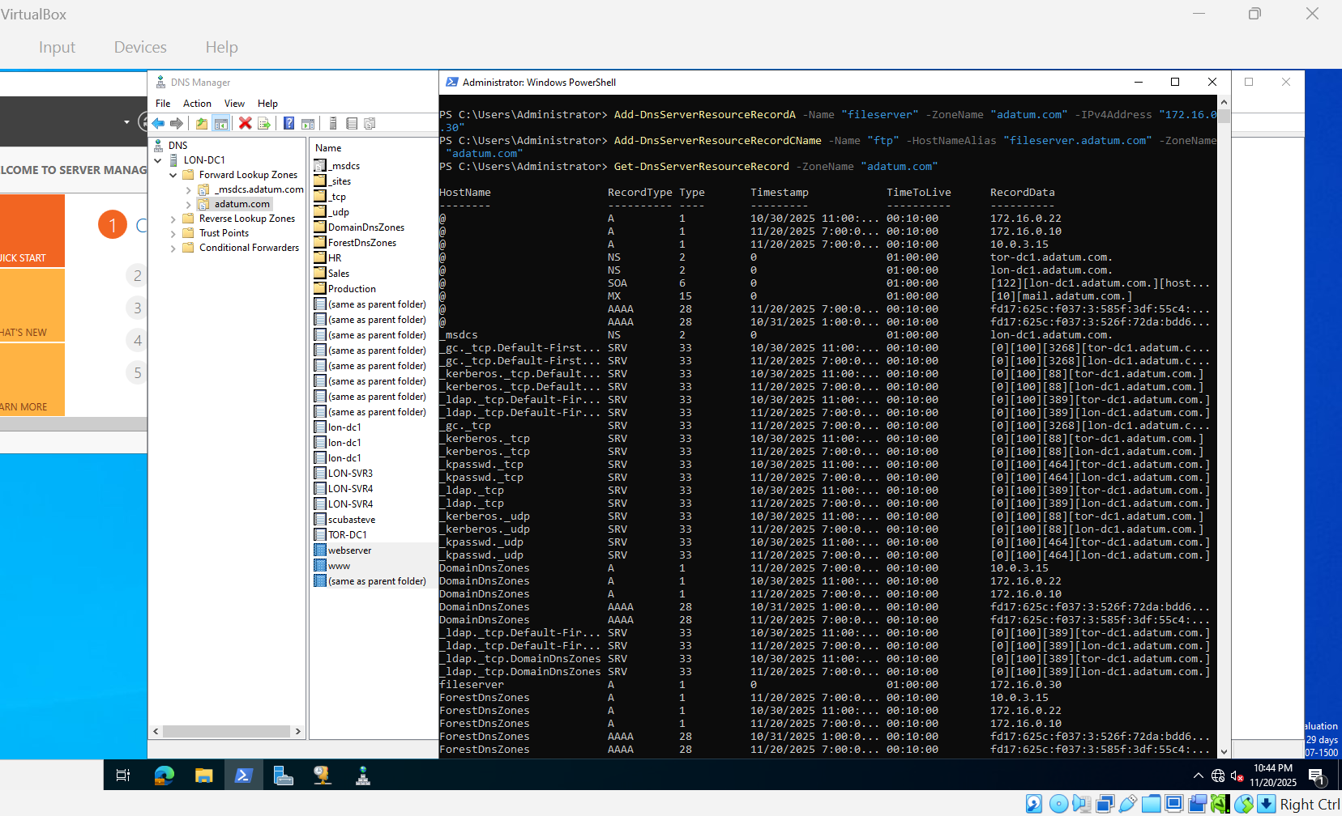
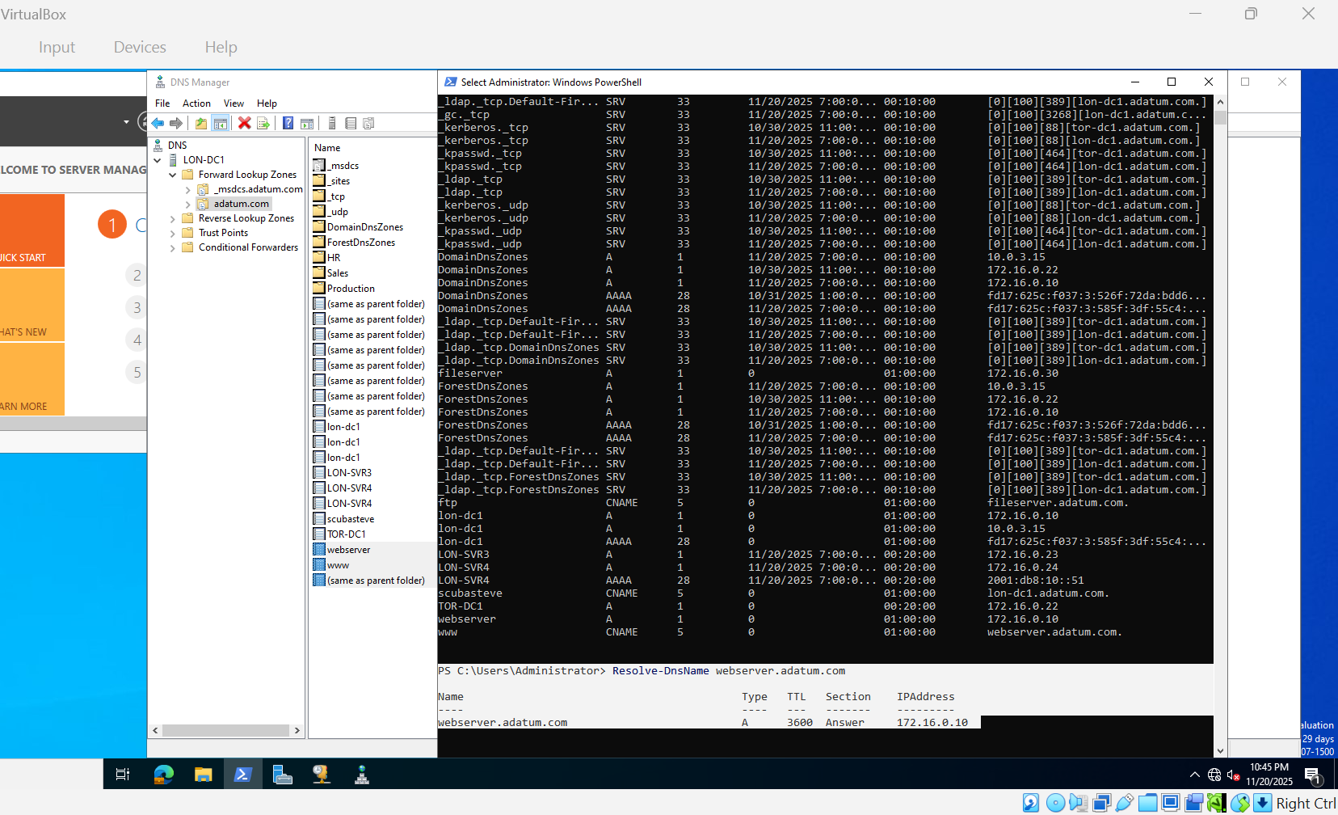
Create Resource Record using Powershell
Added two DNS Server Resource
Viewed test DNS records

